Slide 1
TST12188 4vs4 and 3vs3 comparison RNAseq study of SMN2 splice-modulator lead compounds
Zhen Gao
09/22/2023

Slide 2
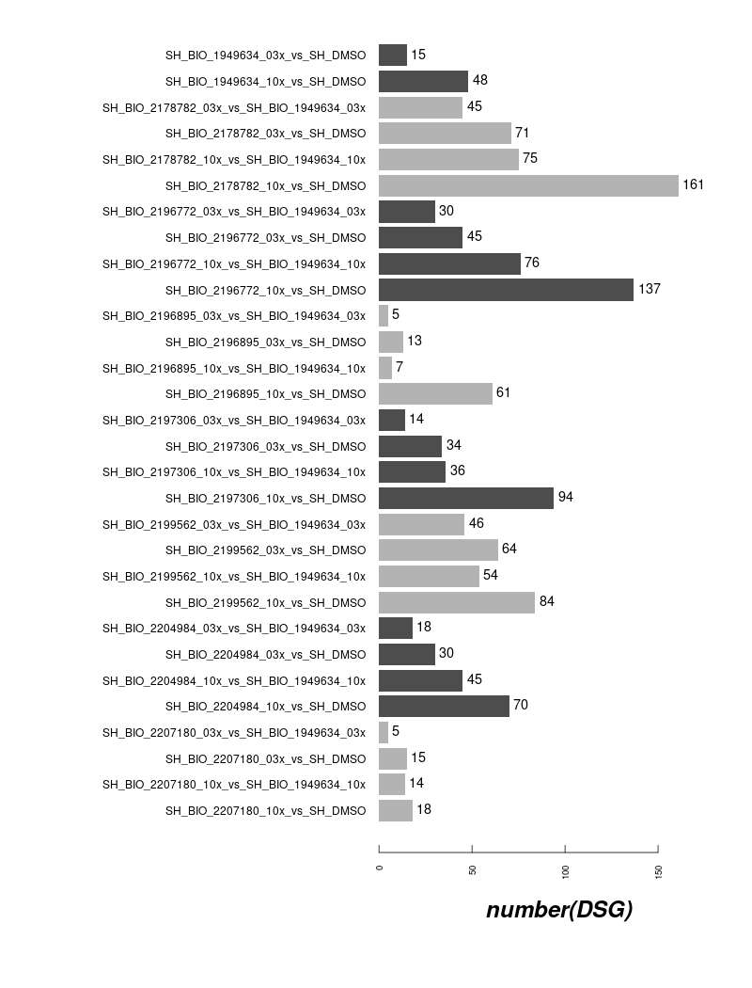
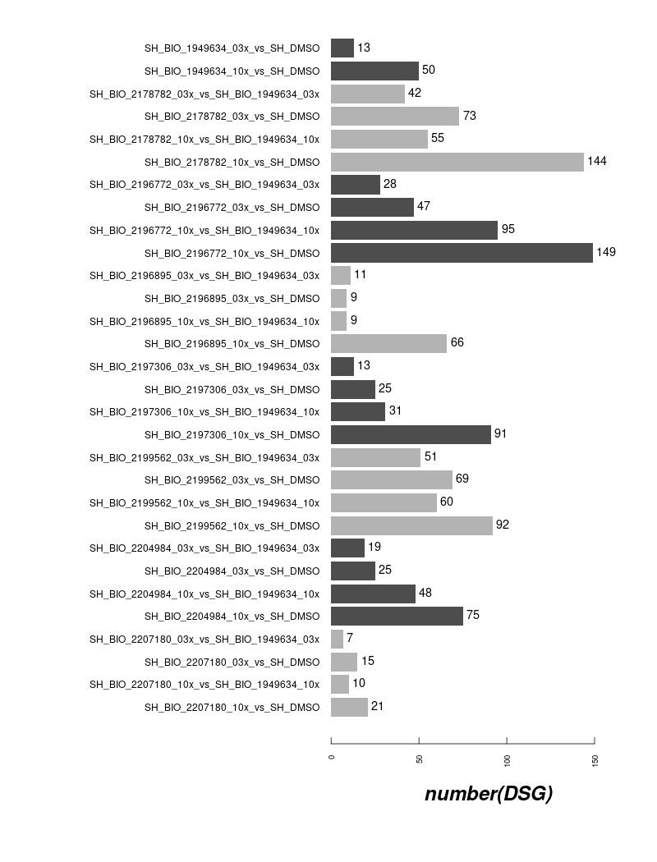
DSG Counts in ShSy5Y off-Targets (7 compounds and risdiplam)
4vs4
3vs3

Slide 3
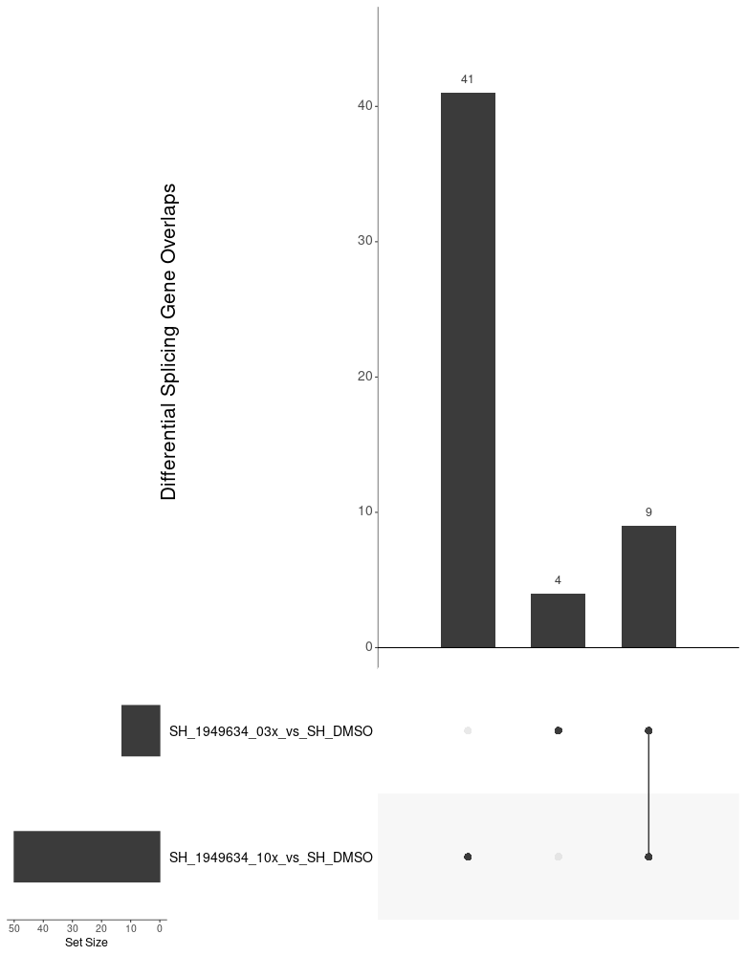
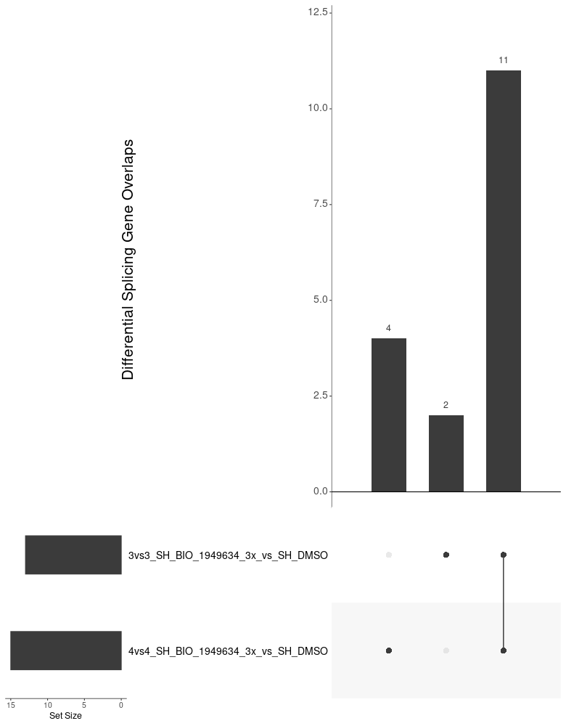
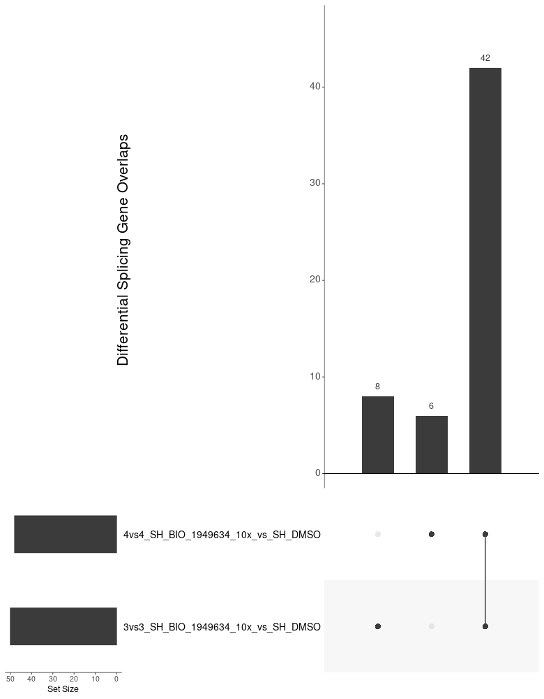
Overview of Compounds in ShSy5Y off-Targets overlap in risdiplam (within 3vs3 setting and cross 3vs3/4vs4 setting)
9/13 DSG induced by 3x Risdiplam were
Covered by 10x Risdiplam in 3vs3 setting
Most DSG induced by 3x Risdiplam
Are consistent across 3vs3 and 4vs4 setting
Super majority of the DSG induced by 10x Risdiplam
Are consistent across 3vs3 and 4vs4 setting

Slide 4
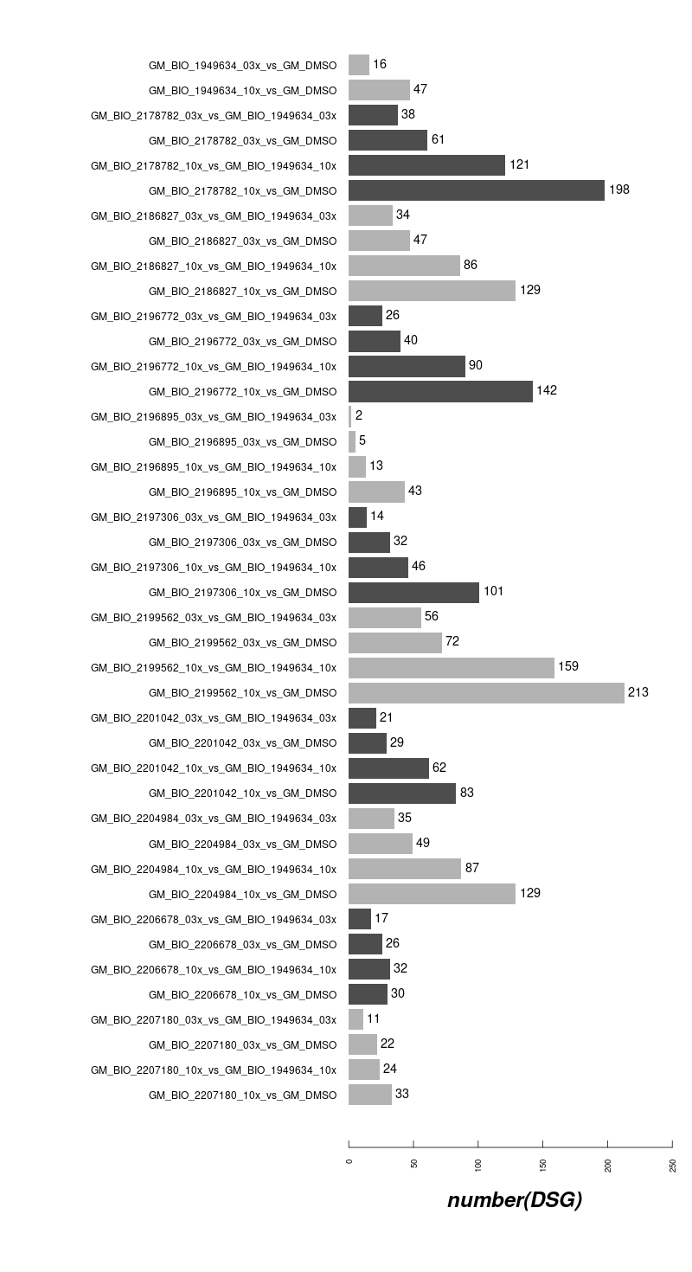

DSG Counts in GM09677c SMA fibroblasts off-Targets (10 compounds and risdiplam)
4vs4
3vs3

Slide 5
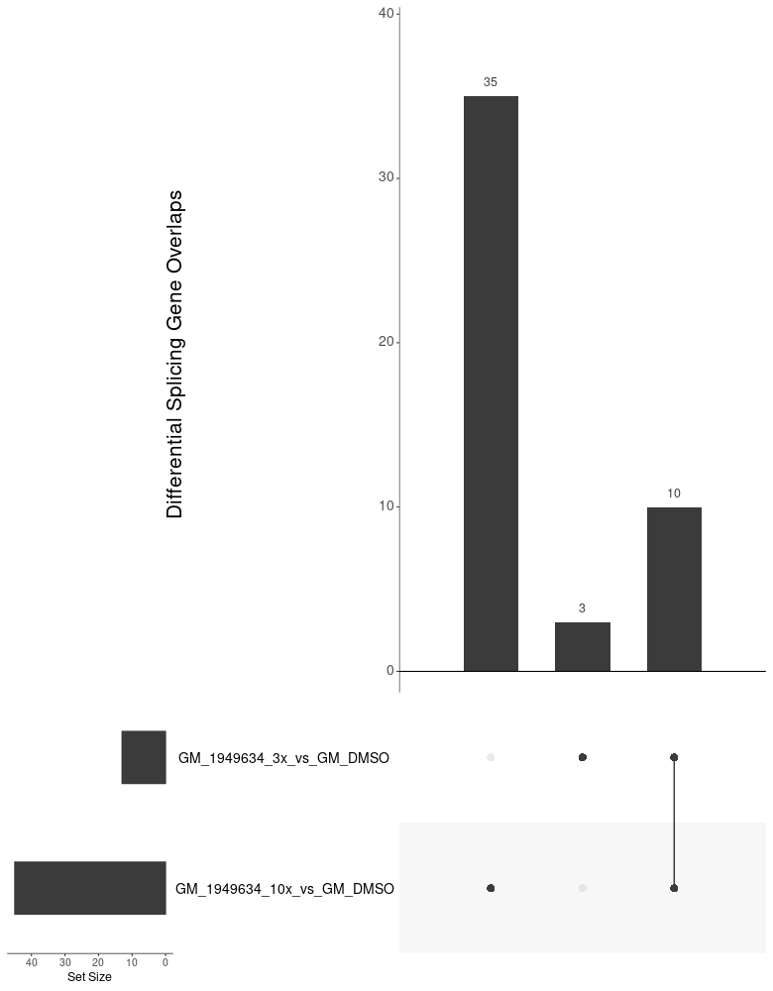
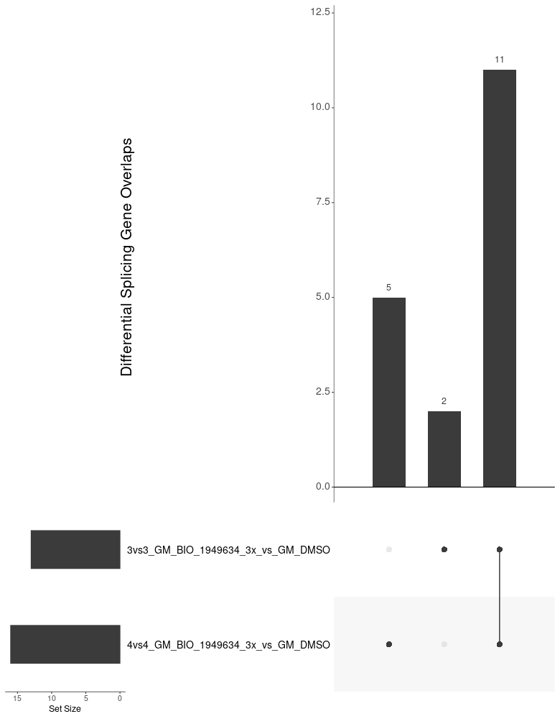

Overview of Compounds in GM09677c off-Targets overlap in risdiplam (within 3vs3 setting and cross 3vs3/4vs4 setting)
10/13 DSG induced by 3x Risdiplam were
Covered by 10x Risdiplam in 3vs3 setting
Most DSG induced by 3x Risdiplam
Are consistent across 3vs3 and 4vs4 setting
Super majority of the DSG induced by 10x Risdiplam
Are consistent across 3vs3 and 4vs4 setting

Slide 6
DEG Counts in ShSy5Y off-Targets (7 compounds and risdiplam)
4vs4
3vs3

Slide 7
DEG Counts in GM09677c SMA fibroblasts off-Targets (10 compounds and risdiplam)
4vs4
3vs3

